Slide 1
Using Data Science for business purpose

Slide 2
Predicting best areas to set up a business
Data Science can be used for determining the most optimal place to set up a business.
By using statistical measures we can determine the best areas by dividing them into different clusters
It can also be used for different industries as well. We can use it to determine socioeconomic status in different regions.

Slide 3
Data acquisition and cleaning
We use data that are readily available from Wikipedia to determine the region separation areas.
https://en.wikipedia.org/wiki/List_of_postal_codes_of_Canada:_M
There are 103 rows of data, but we only use 39 of them (because most are not in the Toronto boroughs)
Boroughs with no neighborhood name were also removed

Slide 4
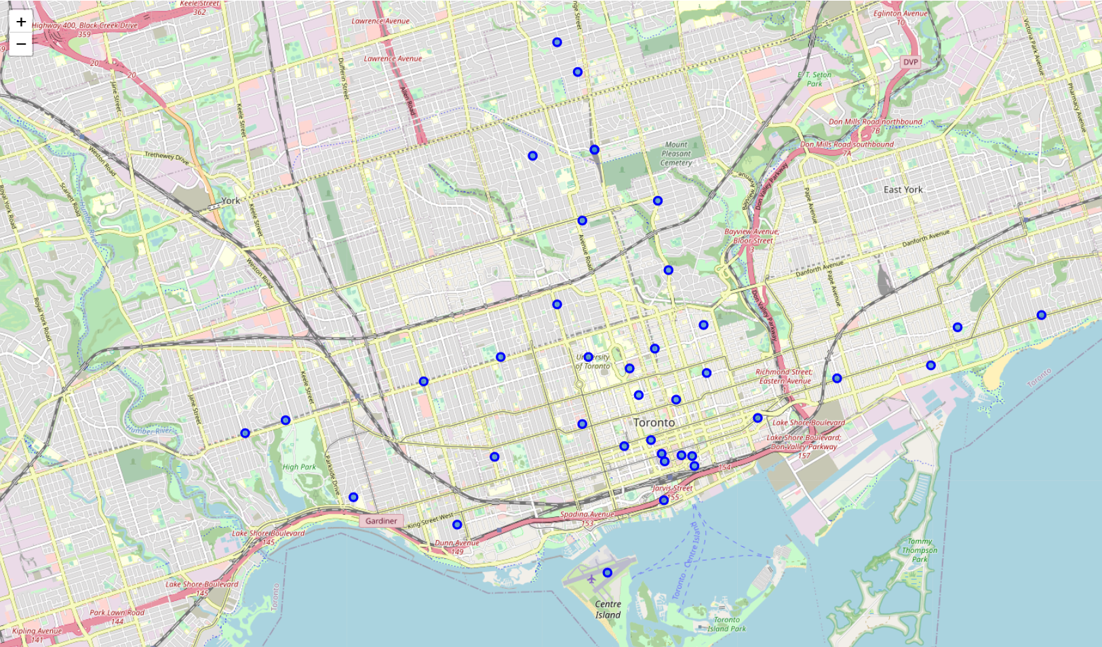
Maps of boroughs used

Slide 5
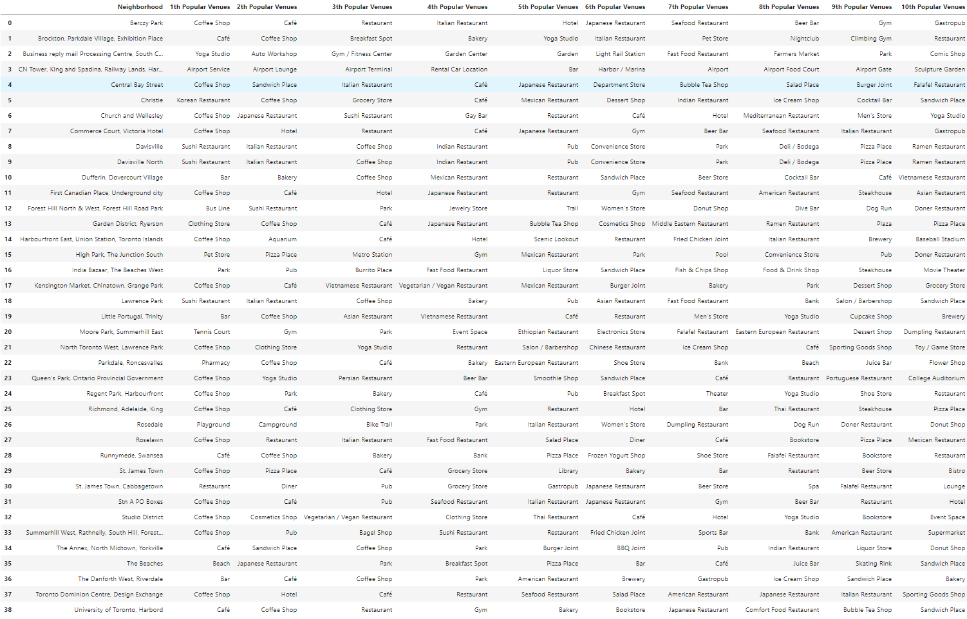
Top 10 frequently visited venues around Toronto regions

Slide 6
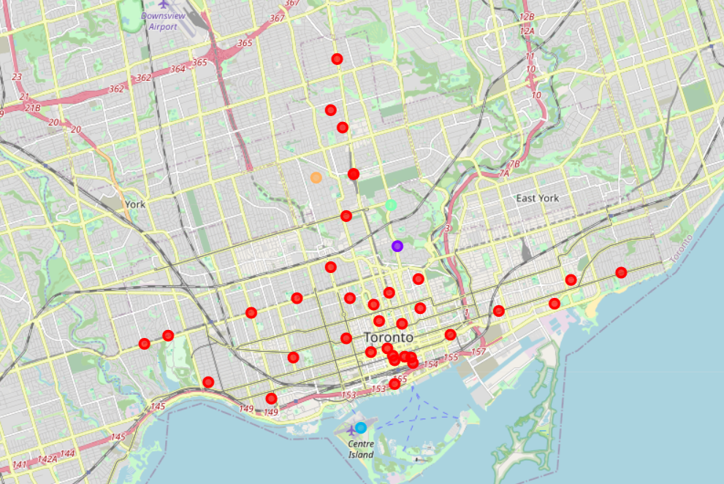
Map of boroughs after being clustered
Red cluster: Cluster 0 (places with coffee shops and beach)
Purple cluster: Cluster 1 (places with many outdoor areas)
Blue cluster: Cluster 2 (Toronto Airport)
Cyan cluster: Cluster 3 (places with many exercise venues)
Orange cluster: Cluster 4 (suburban residential areas)

Slide 7
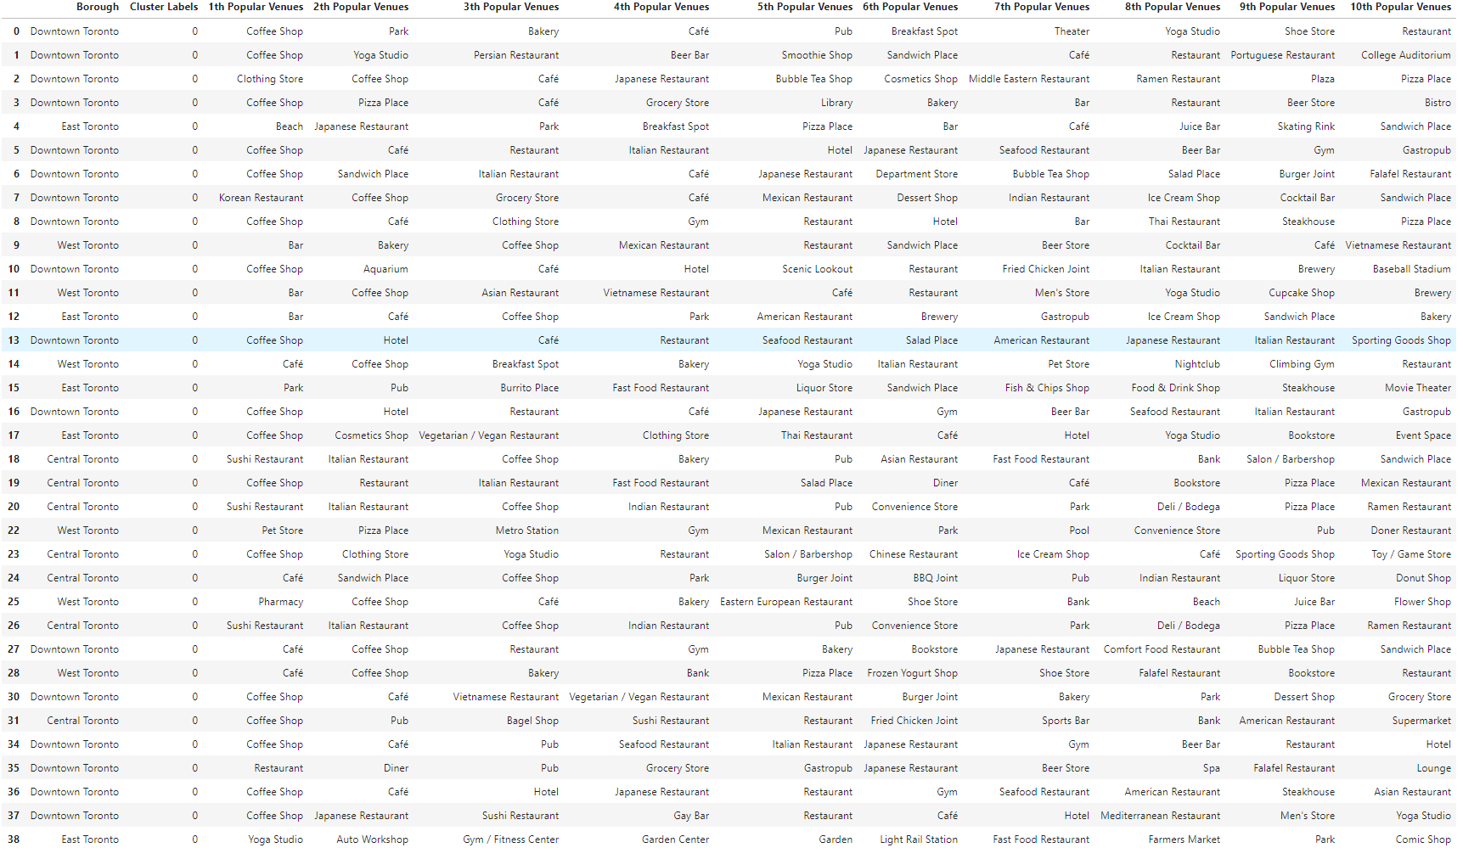
Cluster 0 (places with coffee shop or beach on the top 3 most frequently visited)

Slide 8
Purple cluster: Cluster 1 (places with many outdoor areas)

Slide 9
Blue cluster: Cluster 2 (Toronto Airport)

Slide 10
Cyan cluster: Cluster 3 (places with many exercise venues)

Slide 11
Orange cluster: Cluster 4 (suburban residential areas)

Slide 12
Conclusion
It is advisable to set up a new coffee shop around cluster 1, 2, 3, and 4. Cluster 0 has many coffee shops around the area, so it is not advisable to open a business there due to unnecessary competition.
Final decision on optimal restaurant location will be made by stakeholders based on specific characteristics of neighborhoods and locations in every recommended zone, taking into consideration additional factors like attractiveness of each location (proximity to park or water), levels of noise / proximity to major roads, real estate availability, prices, social and economic dynamics of every neighborhood etc.

